Slide 1
SHUFFLE+
Brought to you by: THEATEAM
Members: Patrick Amato, Brian Chung, Jake Lai, Eric Speaker, David White

Slide 2
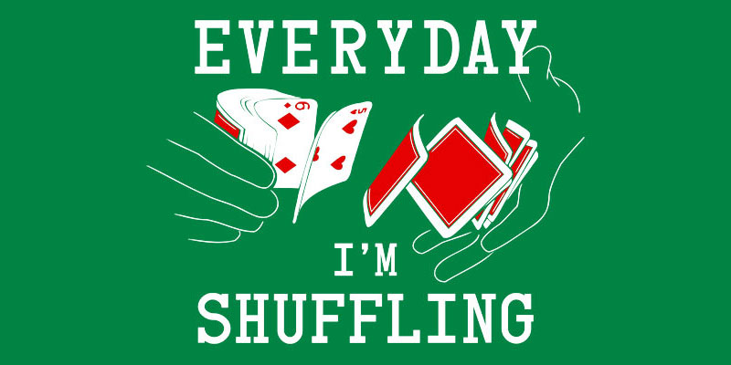
What this app does
Provides more options for playlist shuffling than are typically provided
Offers users a variety of different shuffling algorithms and allows them to specify shuffling criteria

Slide 3



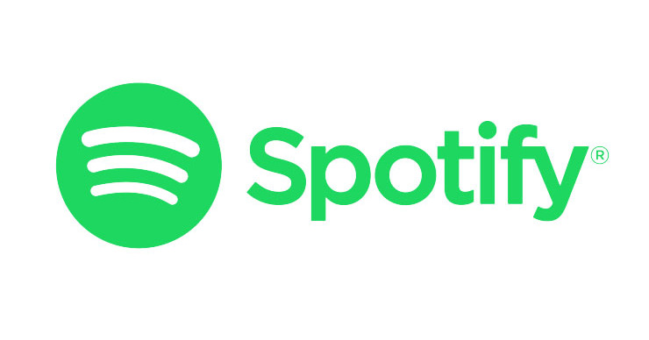

TOOLS
NAME | PURPOSE | RANKING (Out of 5)
Trello | Project tracking | 4
Github | VCS | 5
Nodejs | Web App Framework | 5
Mocha | JS Unit Test Suite | 5
JSDoc | Auto-Doc Tool | 3
Spotify developer API | API | 2.5
Various code development tools | Code Development | 4

Slide 4
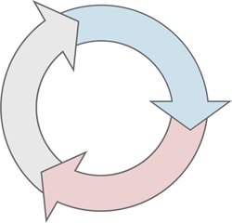
Methodologies Used
Iterative
Pair programming
Peer code reviews

Slide 5
Shuffle Algorithms

Slide 6

Random
Shuffle tracks uniformly randomly
Based on Fisher-Yates shuffle algorithm
Can create strings of songs with the same artist or from the same album which is undesired by many users

Slide 7
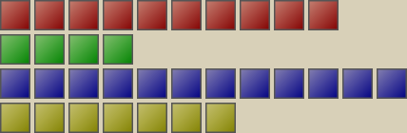
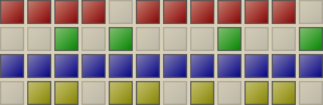
Spread
Spreads songs by the same artist/from the same album/etc apart from one another
Similar to the algorithm used by Spotify

Slide 8
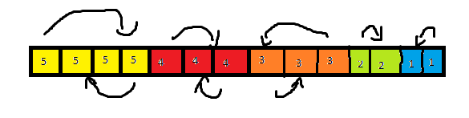
Biased
Allows the users to rank tracks by title, artist, album, or explicit status
Shuffles tracks of the same rank

Slide 9
Challenges Encountered
Had to find work-arounds for spotify’s limited API
Weren’t able to implement our original vision due to limitations from Spotify
Needed to learn some programming languages which limited development at the beginning of project development

Slide 10
Limitations
Weren’t able to implement our original vision due to limitations from Spotify
Seems to be an upper limit on playlist sizes the app can handle
Can only use user created playlists

Slide 11
Moving Forward/Future Developments
Database
Tracker for number of times a song has played
Save some user rankings
Save where user left off in a playlist so that they can leave and resume from the same place
Tie in future Spotify API developments
Allow users to rank by more than one category at a time
Mobile app

Slide 12

Project Demo

